Slide 1

Enhanced Operational Requirements Gathering Using a UX Design Studio Workshop
Blake J. Lesselroth, MD MBI FACP UXC
Associate Professor & Vice Chair
Department of Medical Informatics
University of Oklahoma Tulsa School of Community Medicine
Tulsa, Oklahoma, USA
Kathleen Adams, MPH UXC
Clinical Informatics Evaluation Specialist
Office of Human Factors and Ergonomics
Department of Veterans’ Health Affairs
Portland, Oregon, USA

Slide 2
Disclosures
Authors and presenters have nothing to disclose and no conflicts of interest.

Slide 3
Learning Objectives
Audience should be able to explain the role of UX workshops to engage users, understand a problem, identify solutions, and build consensus
Become familiar with different types of workshops, including design studios; recognize the structure and workflow of a design studio
Describe how a design studio was used to build a high-level understanding of a technology and the software requirements
Learn strategies and activities intended to (1) brainstorm ideas; (2) craft user stories; (3) build consensus; and (4) prioritize a backlog

Slide 4

Background and Problem Statement
The Portland VA Healthcare System is a hospital with seven satellite clinics and a long term care facility; part of 160 hospital system
Whole Health is a collaborative effort sponsored by the VHA Office of Patient Centered Care & Cultural Transformation¹
Whole Health is a shift from clinician-driven, disease management and towards preventative care, and patient-defined outcomes
Portland VA Whole Health team needed a web site for team members and staff; should introduce team, showcases services and events, provide hub for sharing ideas and best practices
Human factors team recruited to (1) engage stakeholders; (2) identify and prioritize website requirements; (3) wireframe design
Portland VAMC
Veterans’ Affairs. https://www.va.gov/patientcenteredcare/explore/about-whole-health.asp, 2017

Slide 5
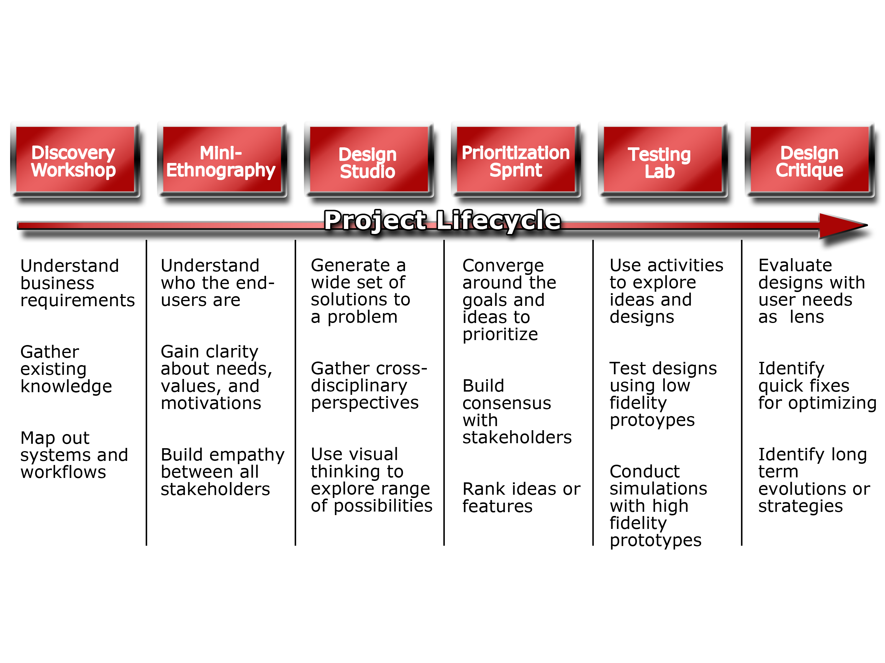
Typical Human Factors Workshops
Adapted from:
Nielsen Norman Group Workshop 2017
Banfield et al, Design Sprint, 2016

Slide 6
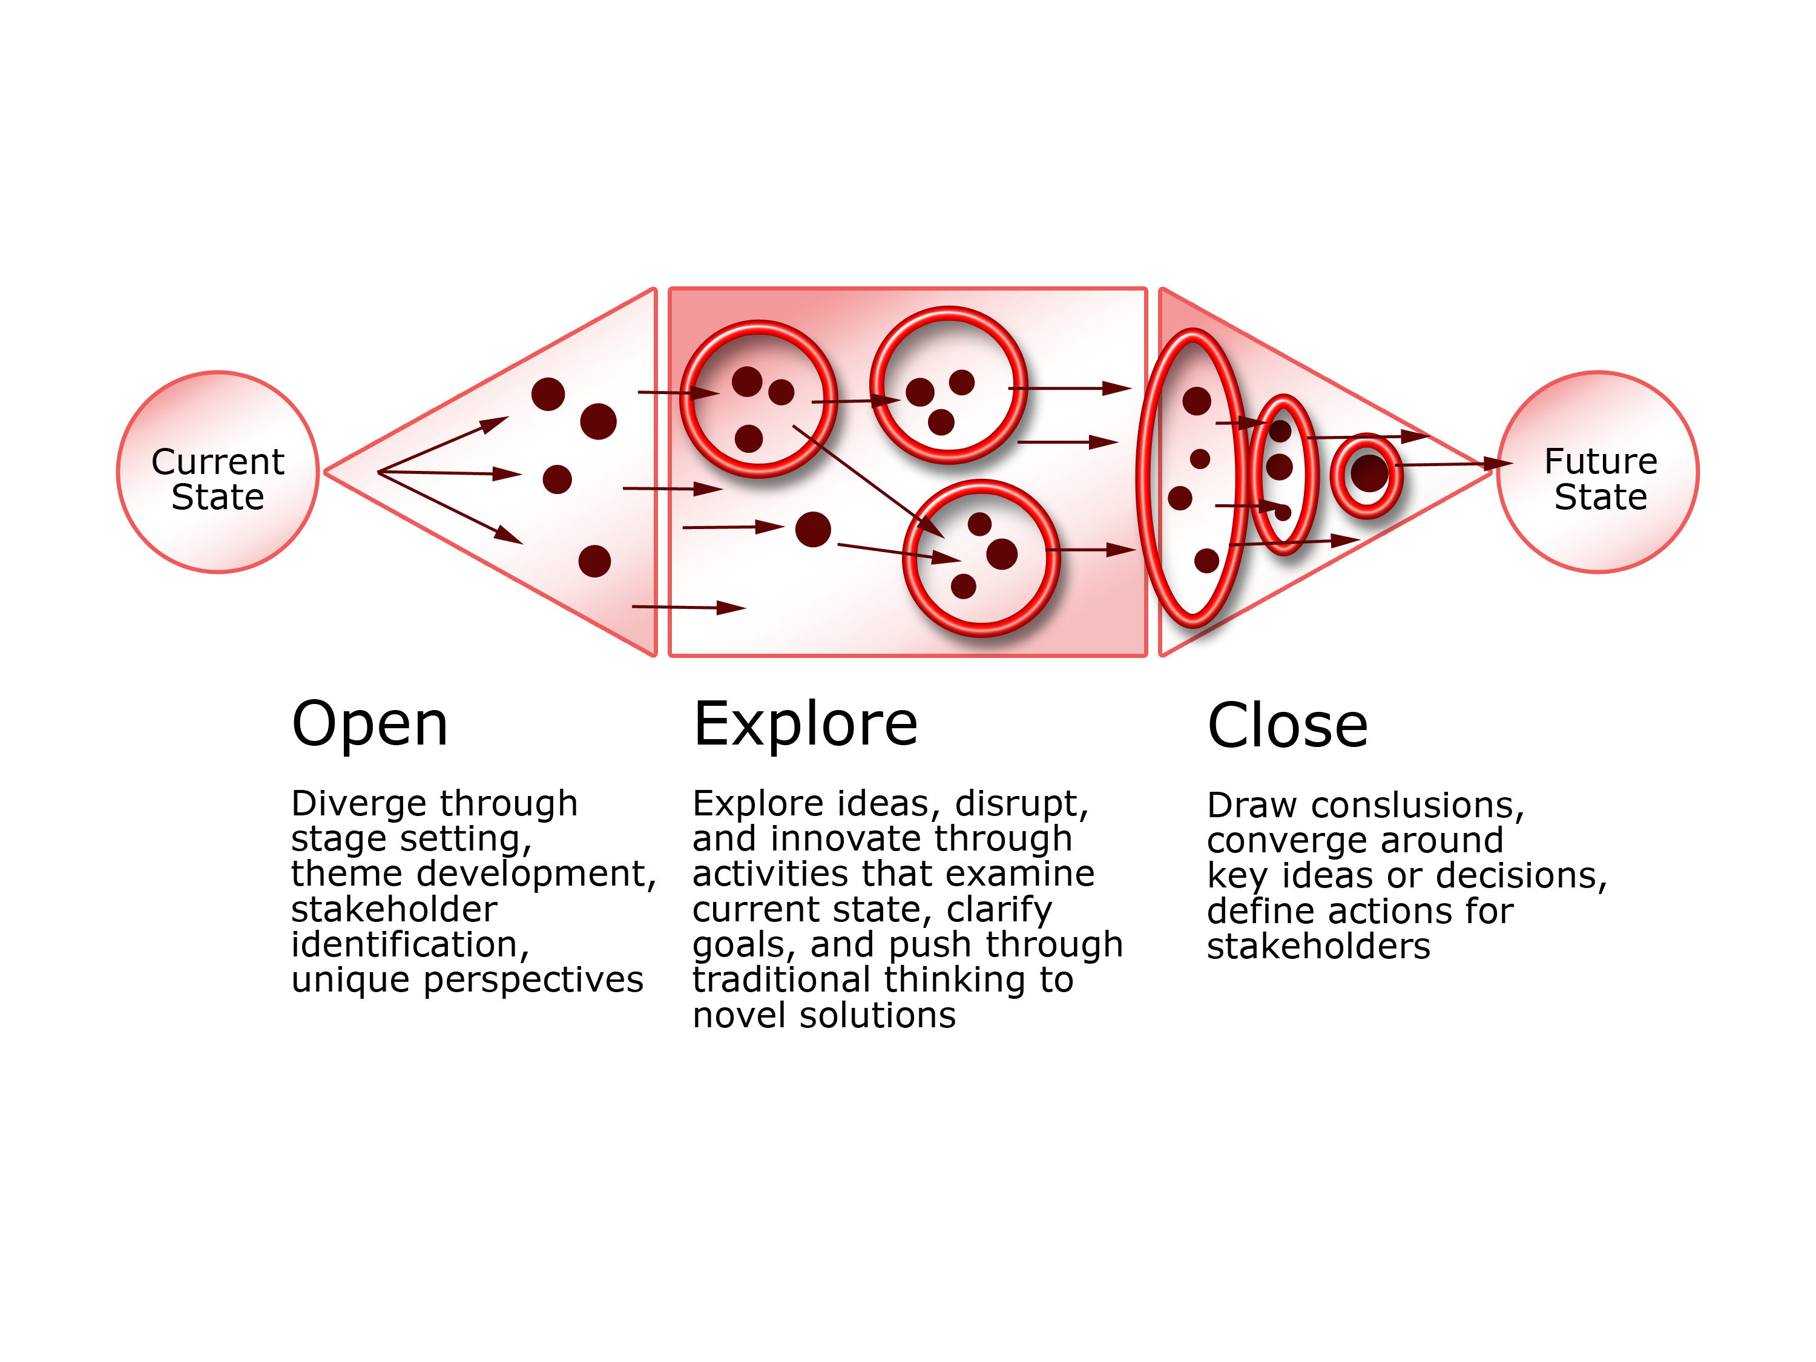
High Level Workshop Structure
Opening
Information gathering
Problem representation
Scoping
Idea generation
Exploring
Refine ideas
Identify themes
Promote understanding
Closing
Focus options
Converge around ideas
Create buy-in
Identify actions
Adapted from Nielson Norman Group 2017

Slide 7
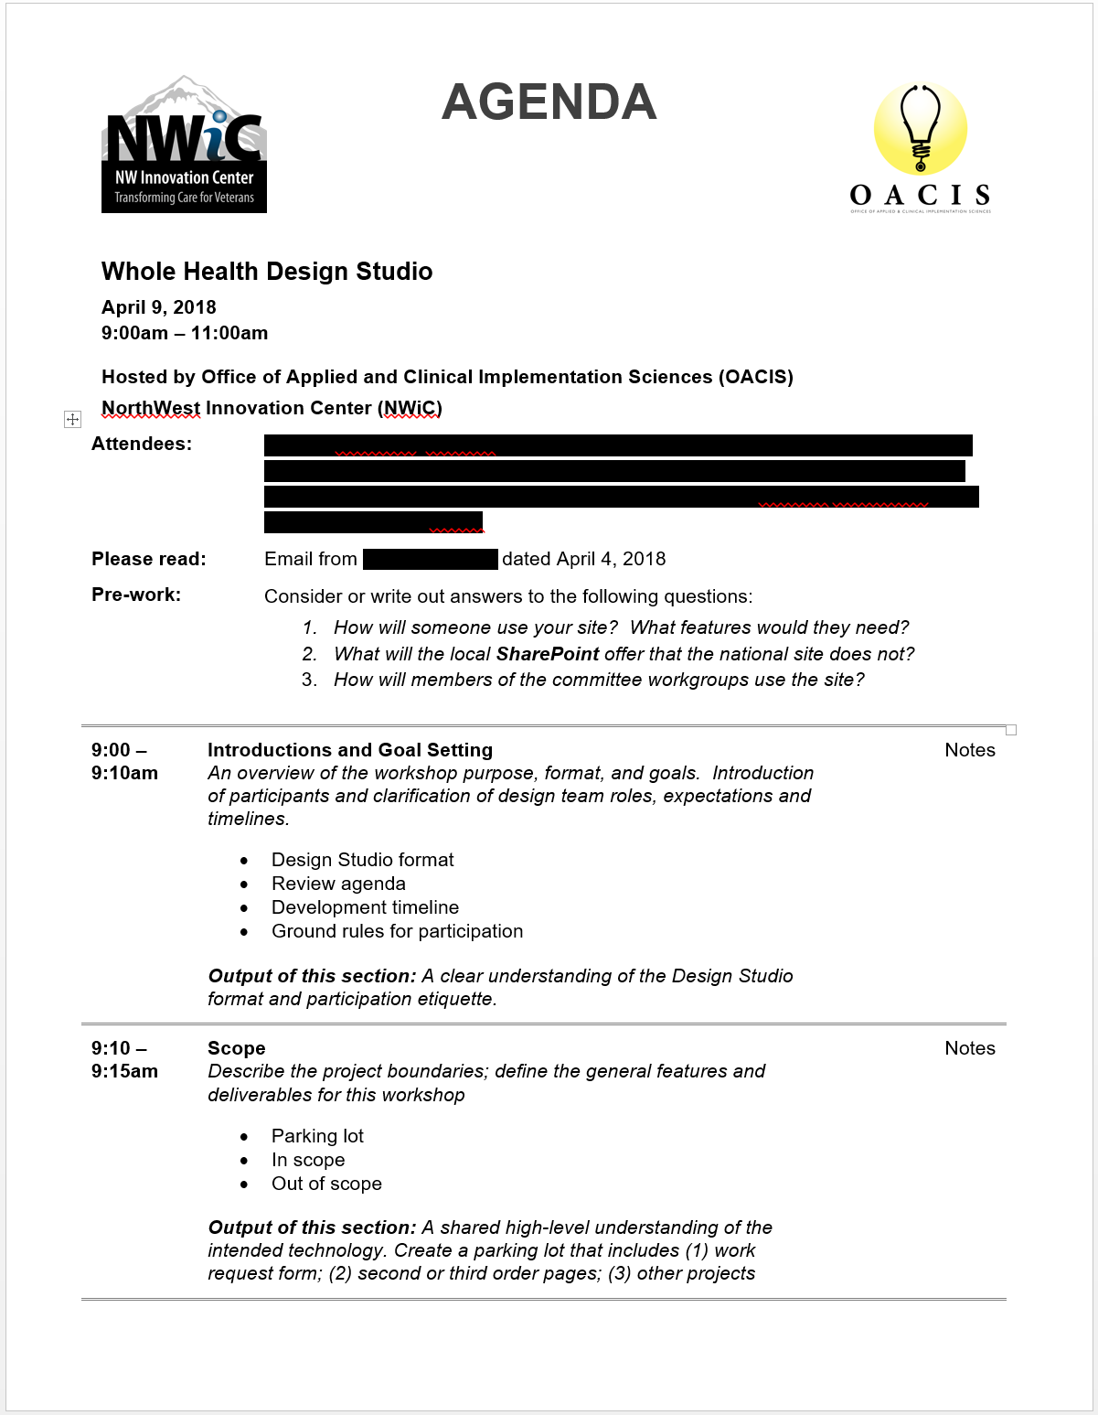
Whole Health Design Studio
Activity 1: Define scope
Activity 2: Audience and purpose
Activity 3: Content identification and prioritization
Activity 4: Design ideation
Activity 5: Closing and actions

Slide 8
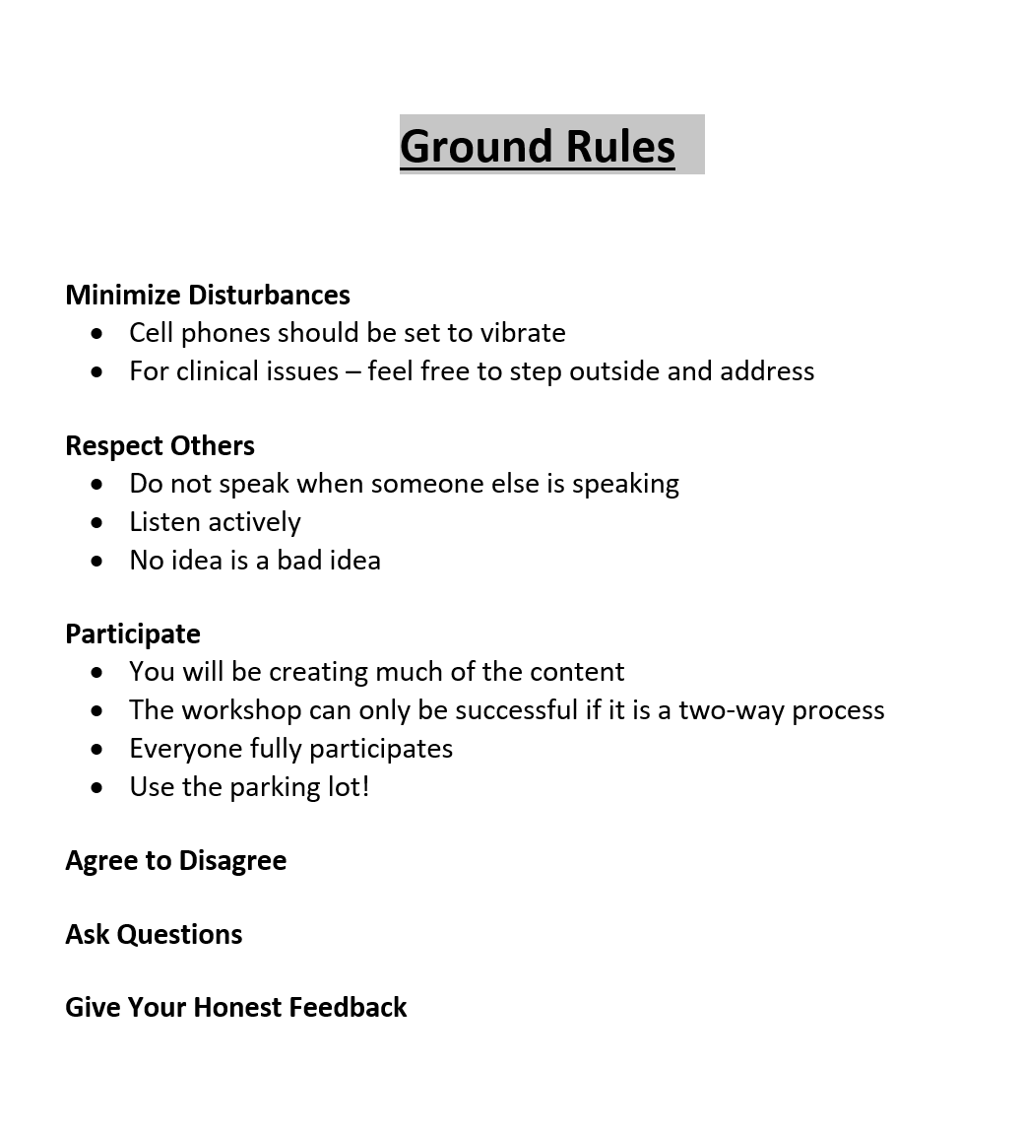
Activity 1: Define Scope
Described the workshop format, rules of engagement, project scope and boundaries
Reviewed goals and deliverables for workshop
Establish a shared understanding of proposed technology
Initial brainstorming to transform ideas into initial work

Slide 9
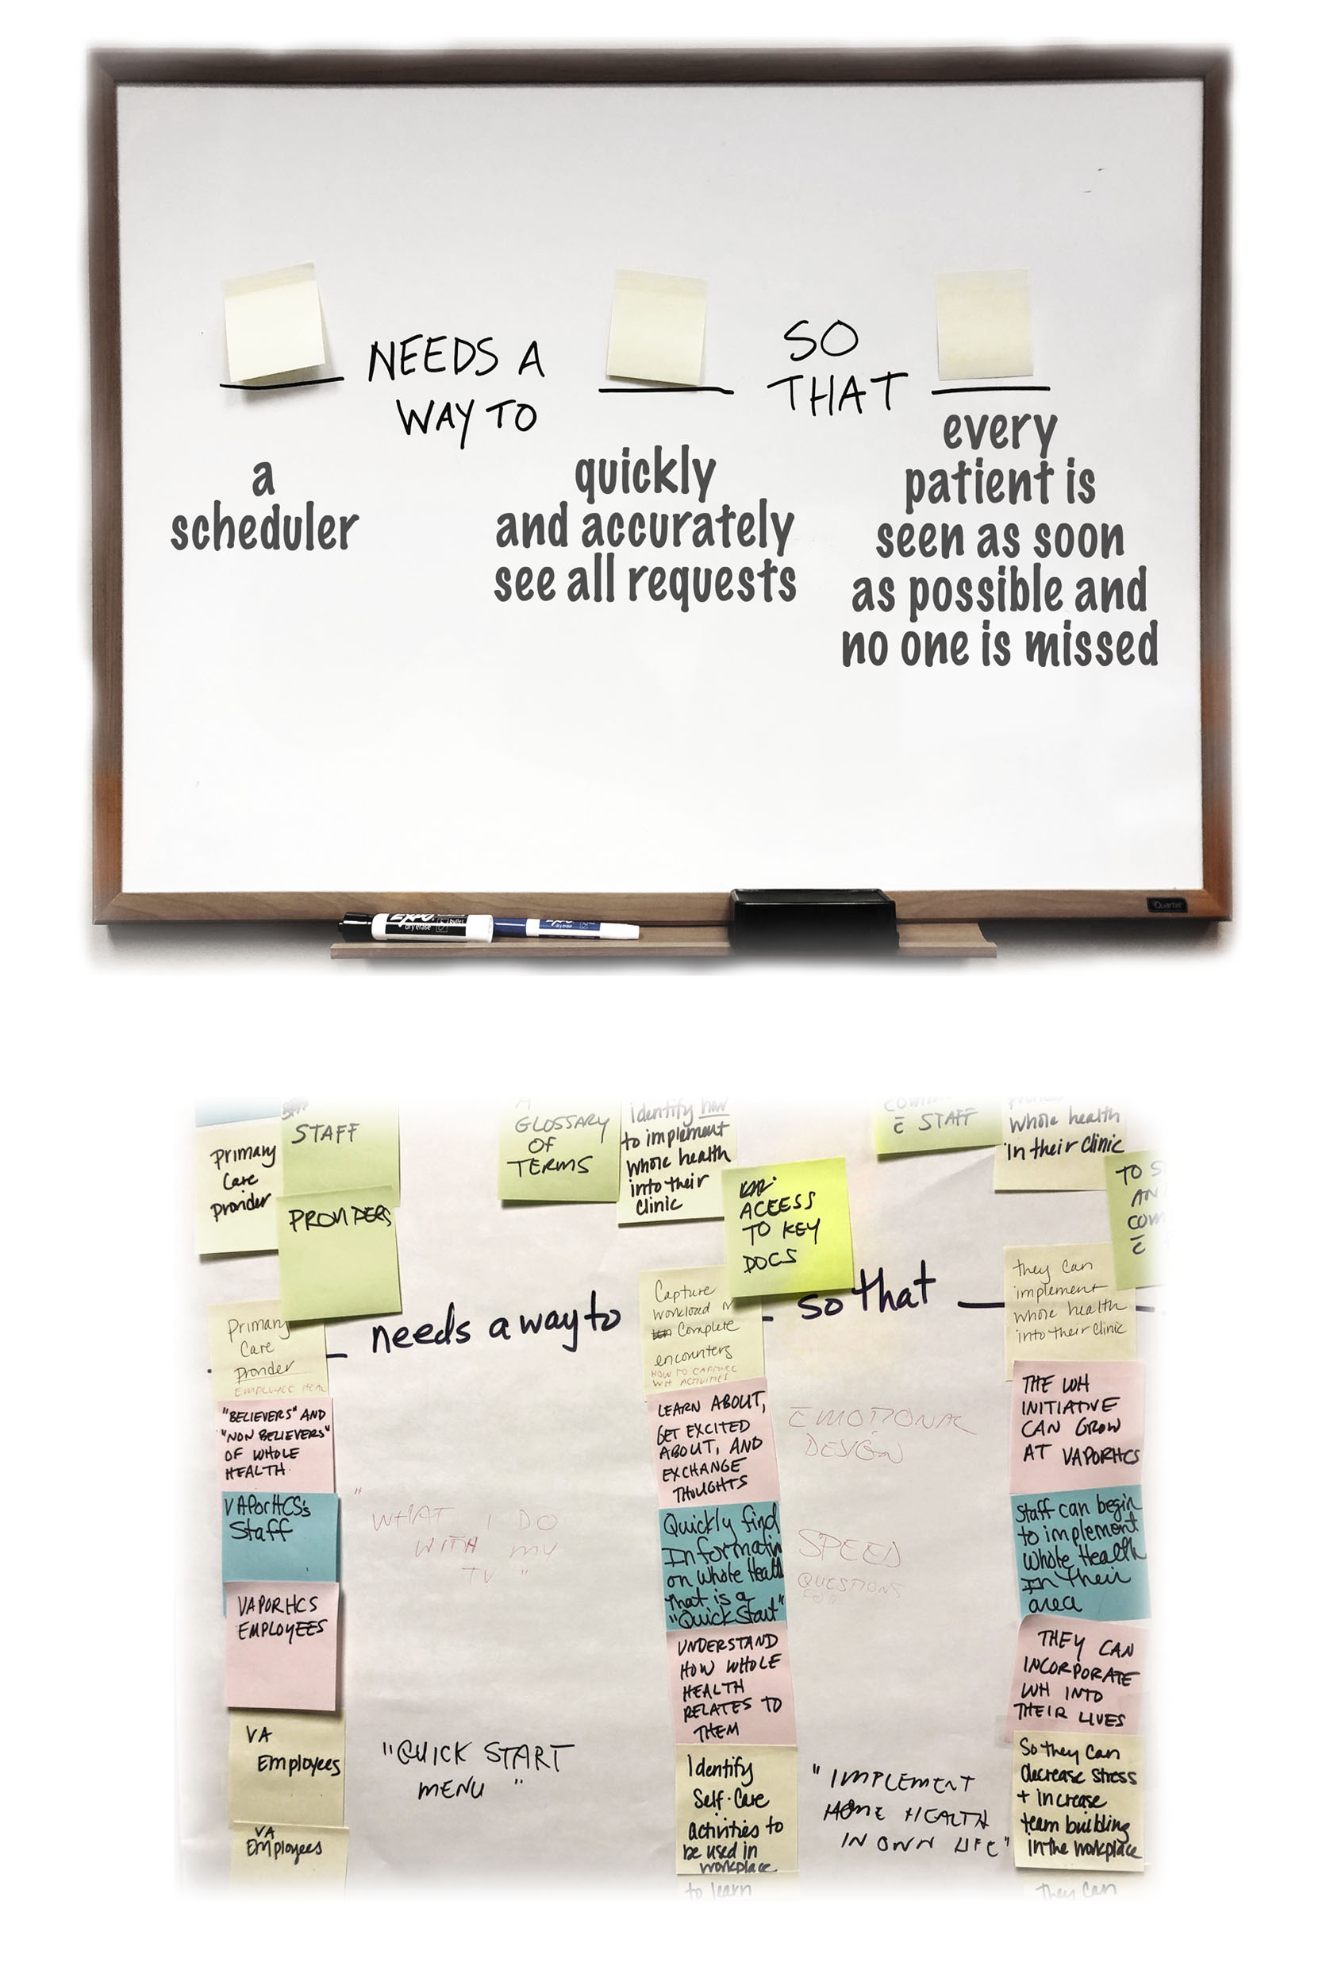
Activity 2: Audience and Purpose
Rapid idea generation (i.e., “ideation”)
Created needs statements that defined the intended user, the high level goal, and the motivation
Post up exercises foster rapid idea generation, group participation, and democratization of creative process¹
Needs statements formatted to assist with next steps: quality improvement activities, implementation research, mini-ethnography, user stories for Agile ceremonies²
Klement, “Replacing the User Story with the Job Story.” http://bit.ly/klement-story

Slide 10
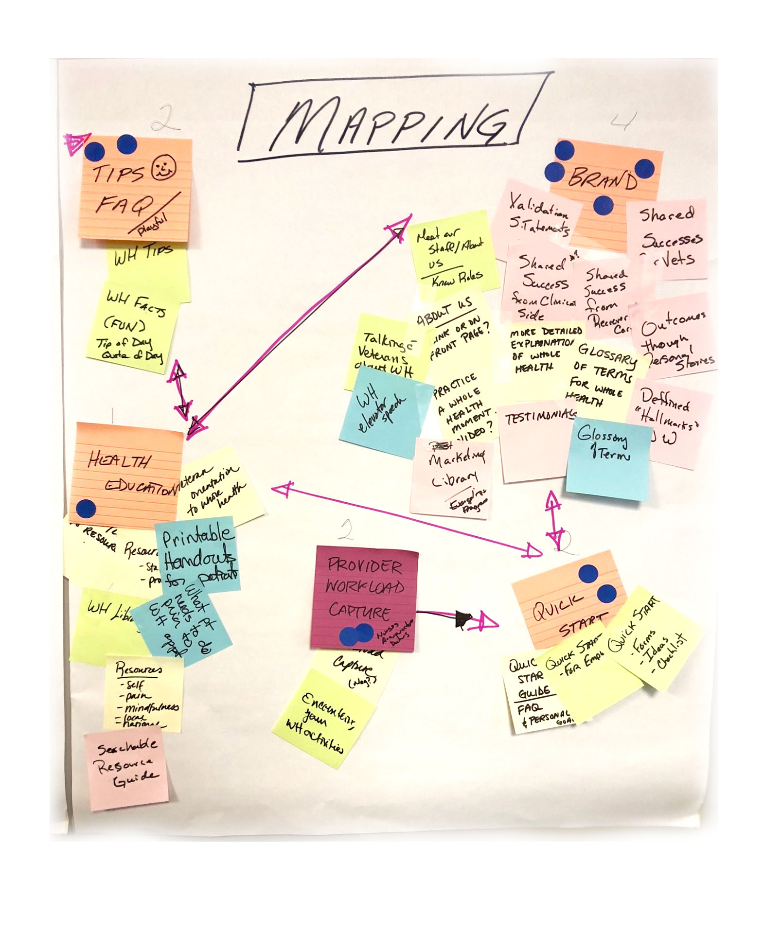
Activity 3: Content Identification and Prioritization
Democratic brainstorming!!!
Generate as many ideas as possible; heavily emphasizes quantity over quality to break through ‘writer’s block’ or ‘group think’ and give voice to each team member
Strategies that help brainstorming include post ups, affinity mapping, mind-mapping, Crazy Eights (i.e., 8 ideas in 5 minutes), storyboarding, brainwriting^{1,2}
For the Whole Health Design Studio, team used post ups and affinity mapping to surface ideas and define themes that could become features
Banfield et al, Design Sprint, 2016
Gray et al, Gamestorming, 2010

Slide 11
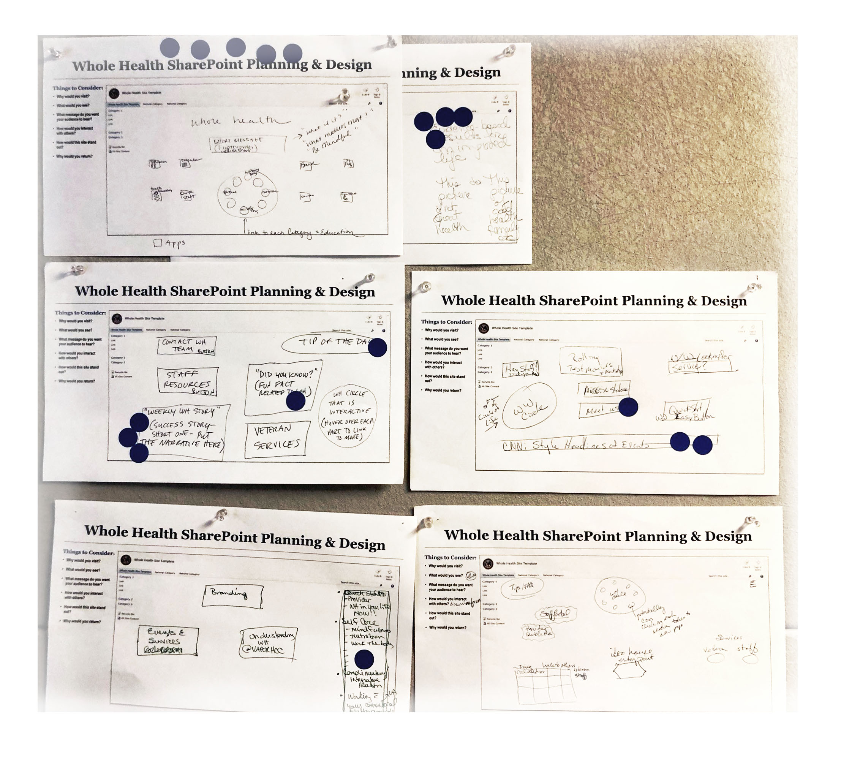
Activity 4: Design Ideation
Requires users to work quickly, suspend critical thinking, and listen to colleagues
Many different strategies can be used; all emphasize quantity over quality and trying to move past features or functions to concepts
Techniques can include sketch ups, team sketches, wireframing, Wizard of Oz, “The Big Idea”^{1,2}
For Whole Health Design Studio, used sketch ups and dot voting
Bernsen et al, CCI Working Papers Cog Sci, 1994
Gibon, Nielsen Norman Group Workshop, 2017

Slide 12
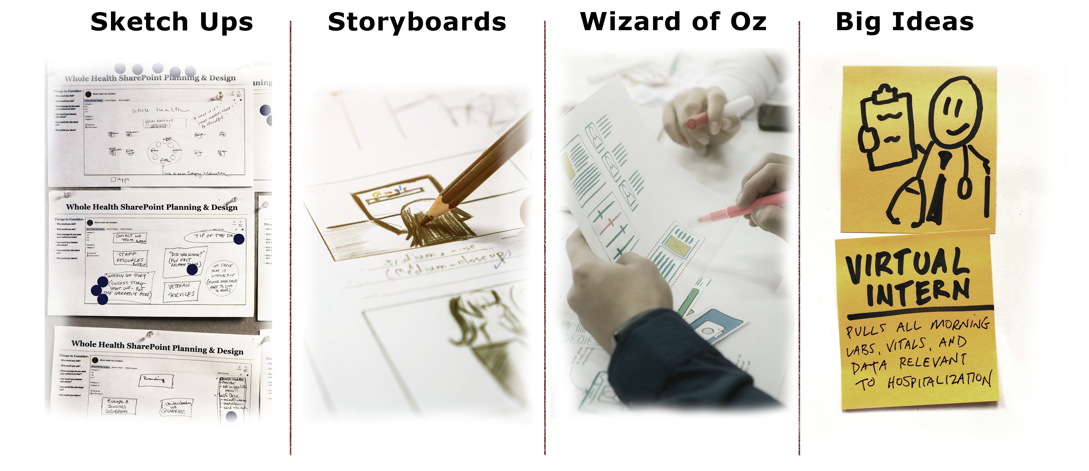
Visual Thinking and Design Techniques
Bernsen et al, CCI Working Papers Cog Sci, 1994
Gibon, Nielsen Norman Group Workshop, 2017

Slide 13
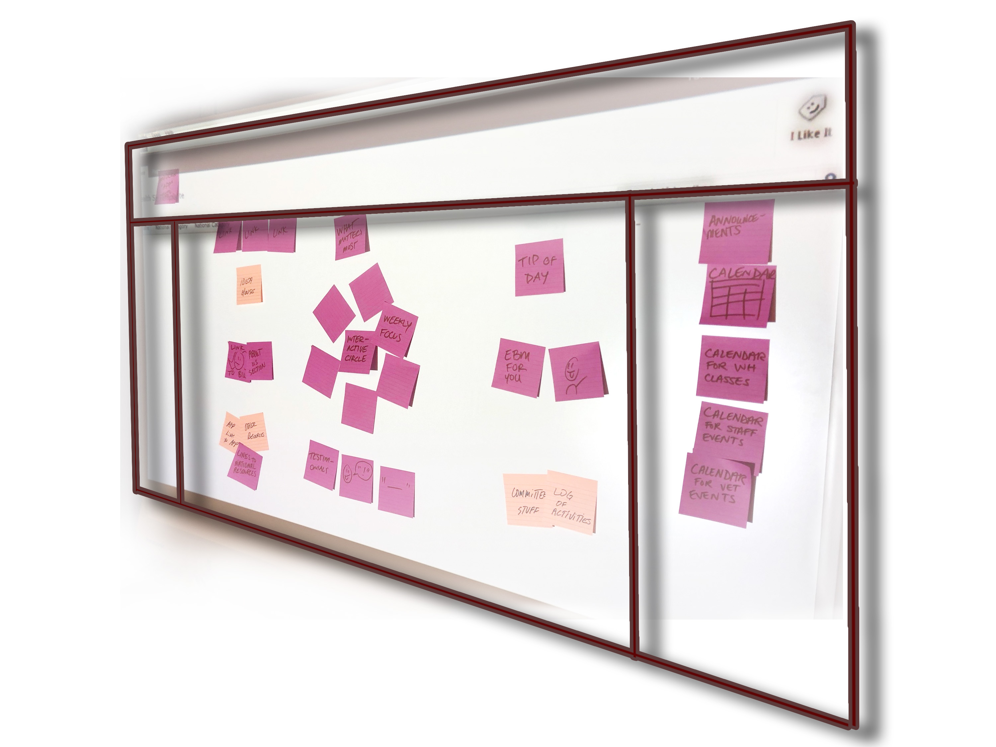
Task 5: Closing and Actions
Bringing things to a conclusion; finding an endpoint through itemization, comparison, voting, alignment
Foster inclusive decisions by strengthening and refining good ideas; prioritizing captured ideas; and aligning expectations
Techniques can include dot voting, NUF test (i.e., new-useful-feasible), $100 test, 2 x 2 plots (i.e., feasibility x impact)
For Whole Health Design Studio, we defined a list of timelines, deliverables, and assignments

Slide 14
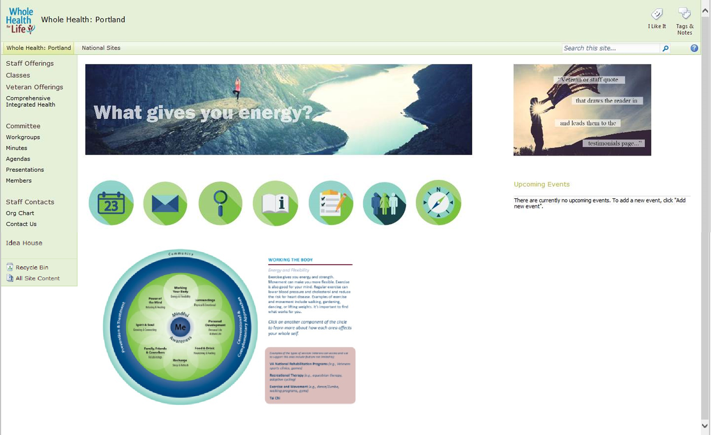
Output and Deliverables
Consensus on features; critical to Agile design teams; provides content for Agile ceremonies and artifacts
Created a set of charter documents that defined project scope, stakeholder buy-in, and testing benchmarks
A set of visual low-fidelity prototypes (i.e., wireframes) for design specifications, storyboards, or testing
Components in hand to run simulations or hybrid-usability tests

Slide 15
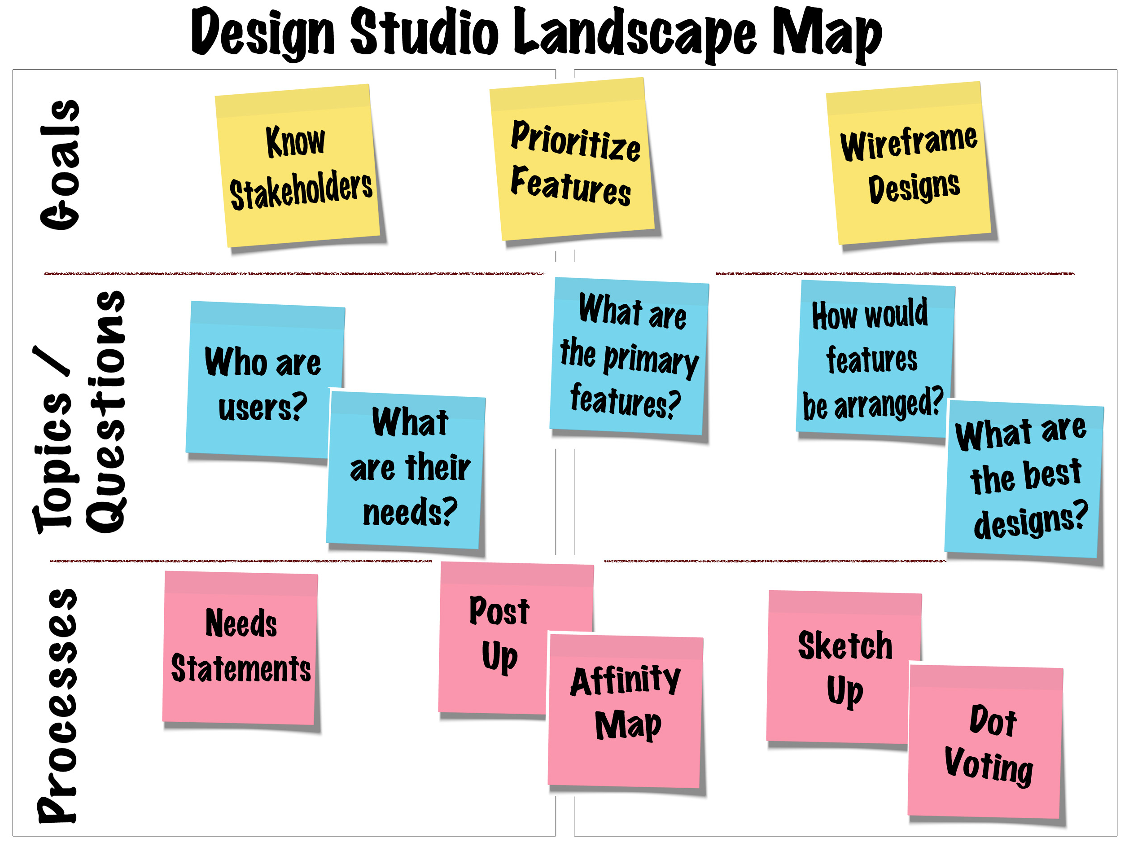
UX Design Studio: Application of ISO Principles

Slide 16
Discussion and Future Work
Workshops and design studios are an efficient method to identify and engage stakeholders; breakthrough creative blocks and surface a wide range of ideas; democratize the project lifecycle and critical features
In a single two-hour meeting, we established how the end-user would interact with the site, the major aims and goals for the site, a feature set and backlog, and requirements and specifications for a development team
Structured and unstructured feedback from the session indicated the Whole Health Design Studio met its stated goals and was well-received by participating stakeholders
Need to create metrics to look at downstream outcomes including, product performance, stakeholder engagement, and other health system or care program objectives

Slide 17
Acknowledgments
Work was funded in part by the VA Portland Healthcare System, the VHA Office of Human Factors and Ergonomics, and the University of Oklahoma OU-TU School of Community Medicine
Contributors:
Stephanie Tallet
Ginnifer Mastarone, PhD
Scott Ragland
Anthony Sayers
Blake.Lesselroth@ouhsc.edu
Kathleen.Adams@va.gov
Victoria, BC, Canada

